Slide 1
Metrology
Tastanbekov Dias B.
2020

Slide 2
Main points and objectives

Slide 3
DEFINITIONS
Metrology is the study of measurements
Measurements are quantitative observations; numerical descriptions
Law in Kazakhstan - Закон Республики Казахстан Об обеспечении единства измерений от 7 июня 2000 года N 53-II
Notes:
https://online.zakon.kz/document/?doc_id=1018417

Slide 4
Glossary
Units of measurement
Standards
Calibration
Traceability
Tolerance
Accuracy
Precision
Errors
Uncertainty

Slide 5
Units of measurement
Units define measurements
Example, gram is the unit for mass
DEFINITIONS MADE BY AGREEMENT
Definitions of units are made by international agreements, SI system

Slide 6
Ultimate reference
Measurements are always made in accordance with external authority
Early authority was Pharaoh’s arm length
Definitions of units are made by international agreements, SI system
Example, kilogram prototype in France
K10 and K20 at NIST
A standard is an external authority
Standard is a physical embodiment of a unit
In chemical and biological assays, substances or solutions used to establish the response of an instrument or assay method to an analyte
See these in spectrophotometry labs
Documents established by consensus and approved by a recognized body that establish rules to make a process consistent
Example ISO 9000
ASTM standard method calibrating micropipettor

Slide 7
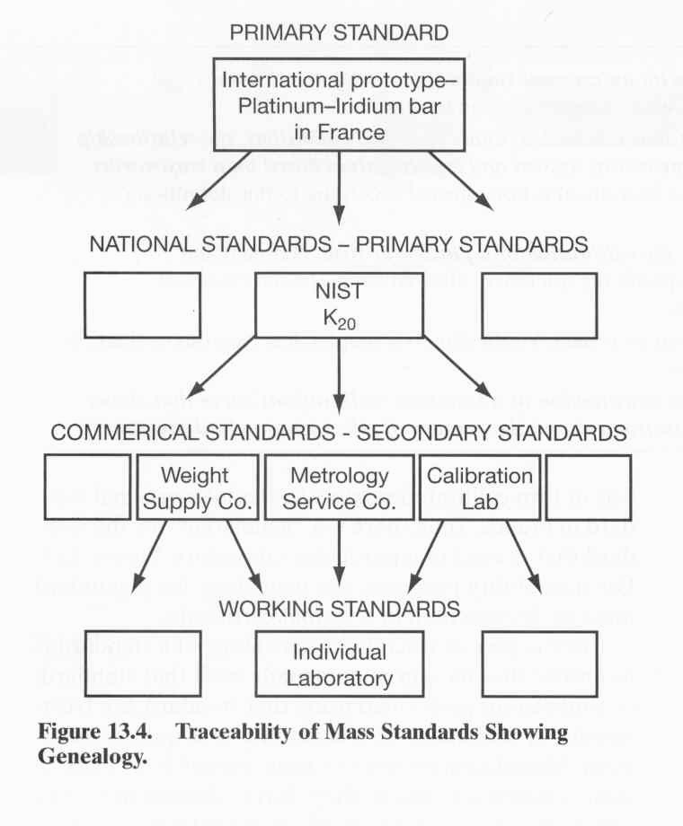

Slide 8
CALIBRATION IS:
Bringing a measuring system into accordance with external authority, using standards
For example, calibrating a balance
Use standards that have known masses
Relate response of balance to units of kg
Do this in lab: pH meter

Slide 9
Tolerance
TRACEABILITY IS:
Amount of error that is allowed in the calibration of a particular item. National and international standards specify tolerances.
E.g. standards for balance calibration can have variation from “true” value
Highest quality 100 g standards have a tolerance of + 2.5 mg
99.99975-100.00025 g
Leads to uncertainty in all weight measurements
The chain of calibrations, genealogy, that establishes the value of a standard or measurement
In the U.S. traceability for most physical and some chemical standards goes back to NIST

Slide 10
ACCURACY AND PRECISION ARE:
Accuracy is how close an individual value is to the true or accepted value
Precision is the consistency of a series of measurements

Slide 11
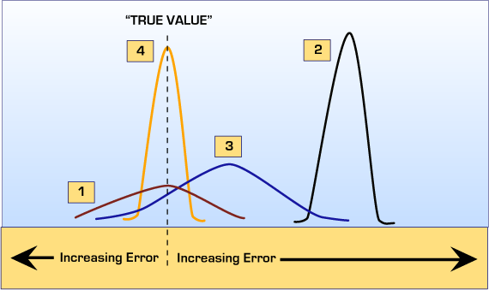
ACCURACY AND PRECISION
Match these descriptions with the 4 distributions in the figure:
Good precision, poor accuracy
Good accuracy, poor precision
Good accuracy, good precision
Poor accuracy, poor precision

Slide 12
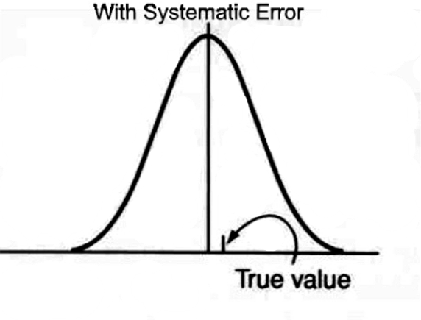
Error
Error is responsible for the difference between a measured value and the “true” value
Types of error:
Gross
Random
Systematic
Blunders
In U.S., weigh particular 10 g standard every day. They see:
9.999590 g, 9.999601 g, 9.999592 g ….
uncertainty in every weight measurement
Estimate of the inaccuracy of a measurement that includes both the random and systematic components.
Systematic error –
Does impact accuracy
Repeating measurements with systematic error does not improve the accuracy of the measurements

Slide 13
Vocabulary used in Metrology
– QUANTITY
(measurable) QUANTITY, attribute of a phenomenon, body or substance that may be distinguished qualitively and determined quantitatively.
Quantities that can be placed in order of magnitude relative to one another are called quantities of the same kind.
Quantities of the same kind may grouped together into categories of quantities.
Symbols of quantities are given in ISO 31
– UNIT (of measurement)
particular quantity, defined and adopted by convention, with which other quantities of the same kind are compared in order to express their magnitudes relatives to that quantity.

Slide 14
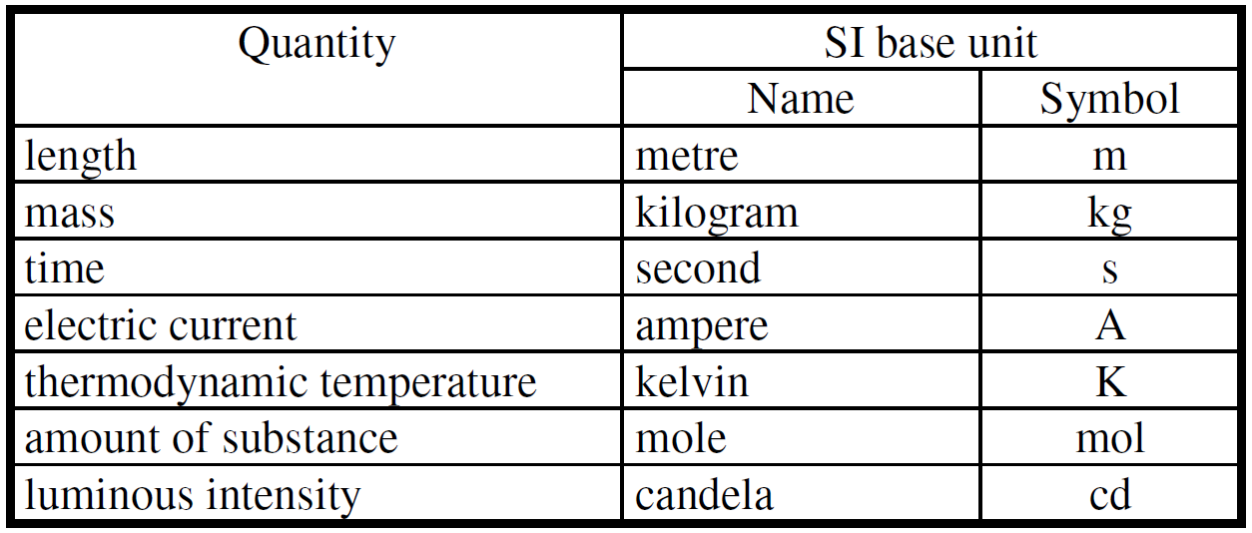
Vocabulary used in Metrology
– International System of Units, SI
the coherent system of units adopted and recommended by the General Conference on Weights and Measure (CGPM).

Slide 15
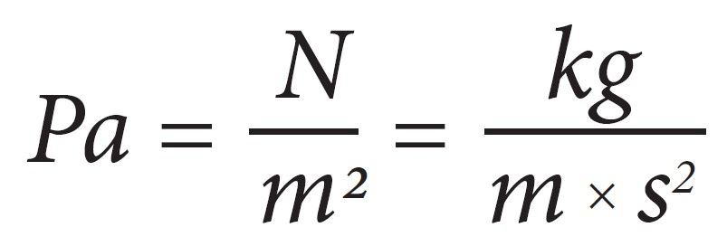
Vocabulary used in Metrology
– DERIVED UNIT (OF MESUREMENT)
unit of measurement of a derived quantity in a given system of quantities.
Derived units = “shortcuts” for convenience in often use

Slide 16
Vocabulary used in Metrology
– TRUE VALUE (OF A QUANTITY)
value consistent with the definition of a given particular quantity.
(True values are by nature indeterminate)
– CONVENTIONAL TRUE VALUE (OF QUANTITY)
value attributed to a particular quantity and accepted, sometimes by convention, as having an uncertainty appropriate for a given purpose
(The CODATA (1986) recommended value for N_{A} = 6,0221367x10²³mol⁻¹)

Slide 17
Vocabulary used in Metrology
– MEASUREMENT
set of operations having the object of determining a value of a quantity.
– METROLOGY
science of measurement.
– PRINCIPLE OF MEASUREMENT
scientific basis of a measurement.
– METHOD OF MEASUREMENT
logical sequence of operations, described generically, used in the performance of measurement.
– MEASUREMENT PROCEDURE
set of operations, described specifically, used in the performance of particular measurements
according to a given method.
– MEASURAND
particular quantity subject to measurement.

Slide 18
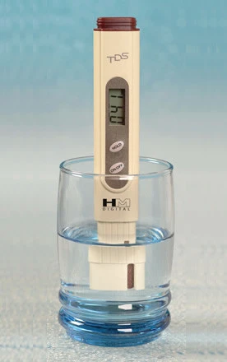
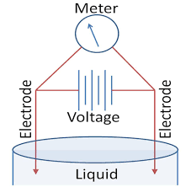
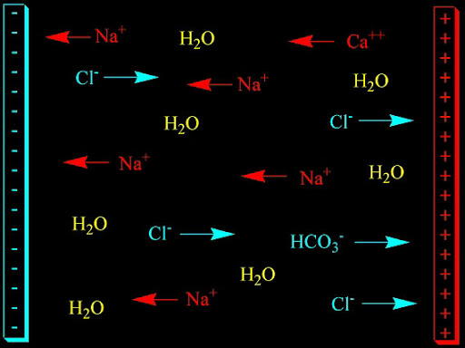
Vocabulary used in Metrology
– INFLUENCE QUANTITY
quantity that is not the measurement but that affects the result of the measurement.
– MEASUREMENT SIGNAL
quantity that represents the measurand and which is functionally related to it.
E.g. TDS-meter working principle
C = f(σ)
C - concentration
σ - conductivity

Slide 19
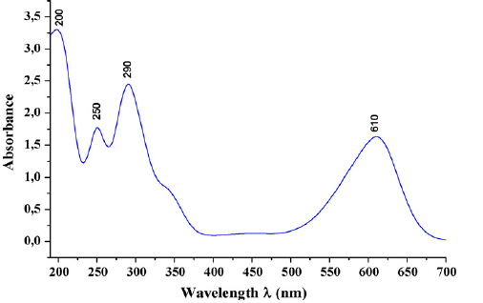
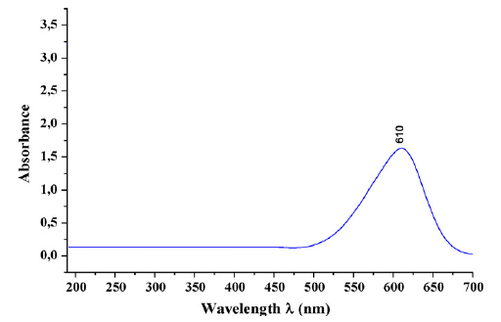
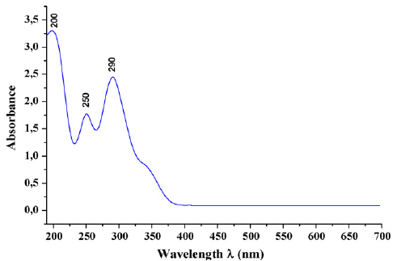
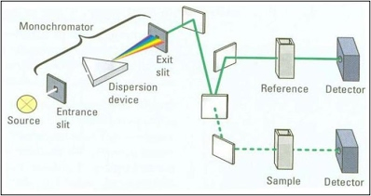
Vocabulary used in Metrology
– RESULT OF A MEASUREMENT,
value attributed to a measurand, obtained by measurement.
– UNCORRECTED RESULT
result of a measurement before correction for systematic error.
– CORRECTED RESULT
result of a measurement after correction for systematic error.

Slide 20
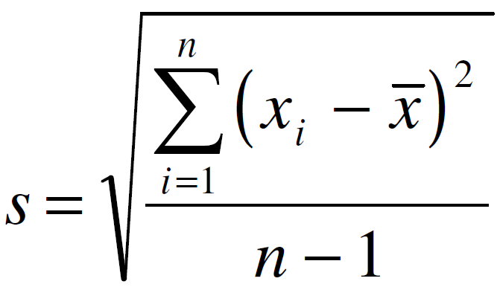
Vocabulary used in Metrology
– ACCURACY OF MEASUREMENT
closeness of the agreement between the result of a measurement and a true value of a measurand.
– REPEATABILITY (OF RESULTS OF MEASUREMENTS)
closeness of the agreement between the result of successive measurements of the same measurand
carried out under the same conditions of measurement.
– REPRODUCIBILITY (OF RESULTS OF MEASUREMENTS)
closeness of the agreement between the results of measurements of the same measurand carried out
under changed conditions of measurement.
– EXPERIMENTAL STANDARD DEVIATION
for a series of n measurements of the same measurand, the quantity s characterizing the dispersion
of the results and given by the formula:

Slide 21
Vocabulary used in Metrology
– MEASURING INSTRUMENT
device intended to be used to make measurements, alone or in conjunction with supplementary device(s).
– MATERIAL MEASURE
device intended to reproduce or supply, in a permanent manner during its use, one or more known values of a given quantity.
– MEASURING TRANSDUCER
device that provides an output quantity having a determined relationship to the input quantity (e.g. thermocouple, current transformer, strain gauge, pH electrode).
– MEASURING CHAIN
series of elements of a measuring instrument or system that constitues the path of the measurement signal from the input to the output.
– MEASURING SYSTEM
complete set of measuring instruments and other equipment assembled to carry out specified measurements.
– SENSOR
element of a measuring instrument or measuring chain that is directly affected by the measurand.
– DETECTOR
device or substance that indicates the presence of a phenomenon without necessarily providing a value of an associated quantity.

Slide 22
Exercise
MEASURING INSTRUMENT MATERIAL MEASURE MEASURING TRANSDUCER MEASURING CHAIN MEASURING SYSTEM

Slide 23
Vocabulary used in Metrology
– GAUGING (OF A MEASURING INSTRUMENT)
operation of fixing the positions of the scale marks of a measuring instrument in relation to the corresponding values of the measurands.
– ADJUSTMENT (OF A MEASURING INSTRUMENT)
operation of bringing a measuring instrument into a state of performance suitable for its use.
– SPAN
modulus of the difference between the two limits of a nominal range.
– MEASURING RANGE WORKING RANGE
set of values of measurands for which the error of a measuring instrument id intended to lie within specified limits.
– RATED OPERATING CONDITIONS
conditions of use for which specified metrological characteristics of a measuring instrument are intended to lie within given limits.
– LIMITING CONDITIONS
extreme conditions that a measuring instrument is required to withstand without damage, and without degradation of specified metrological characteristics when it is subsequently operated under its rated operating conditions.
– REFERENCE CONDITIONS
conditions of use prescribe for testing the performance of a measuring instrument or for intercomparison of results of measurements.

Slide 24
Vocabulary used in Metrology
– RESPONSE CHARACTERISTIC
relationship between a stimulus and the corresponding response, for defined conditions.
– SENSITIVITY
change in the response of a measuring instrument divided by the corresponding change in the stimulus.
– STABILITY
ability of a measuring instrument to maintain constant its metrological characteristics with time.
– TRANSPARENCY
ability of a measuring instrument not to alter the measurand.
– DRIFT
slow change of a metrological characteristic of a measuring instrument.
– RESPONSE TIME
time interval between the instant when a stimulus is subjected to a specified abrupt change and the instant when the response reaches and remains within specified limits around its final steady value.
– INTRINSIC ERROR (OF A MEASURING INSTRUMENT)
error of a measuring instrument, determined under reference conditions.

Slide 25
Measurements:
Degree, Minute & Seconds (DMS) → Degrees
Km/h → m/s
Kelvin → Celsius

Slide 26
Exercises
Vernier caliper
Micrometer,
TDS-meter calibration
pH-meter calibration

Slide 27
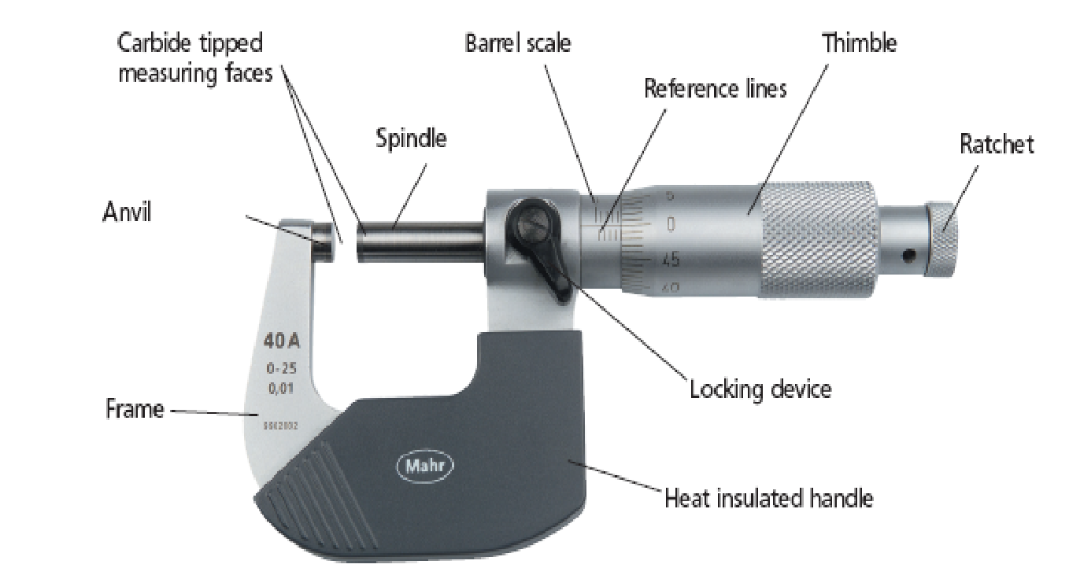
Micrometer
.

Slide 28
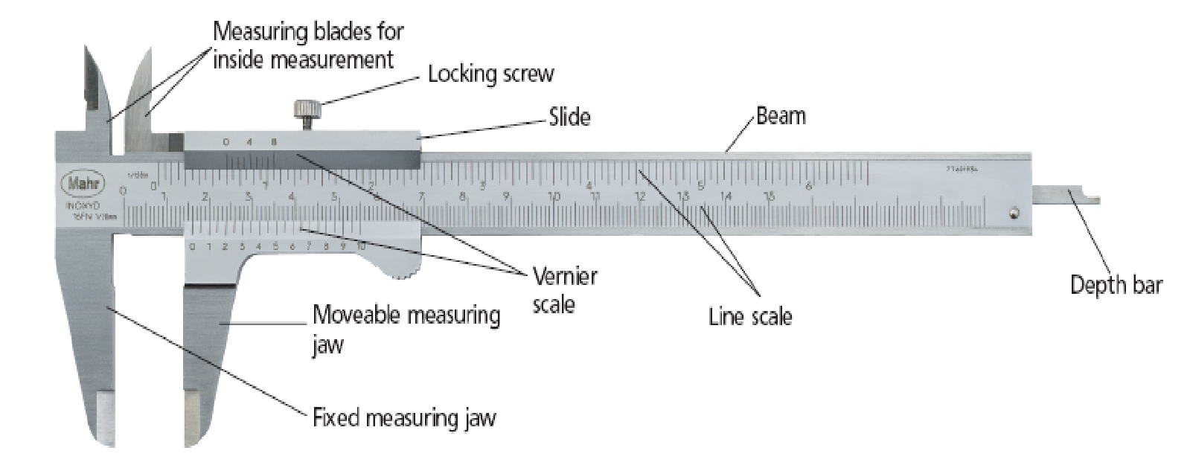
Vernier Calliper
.

Slide 29
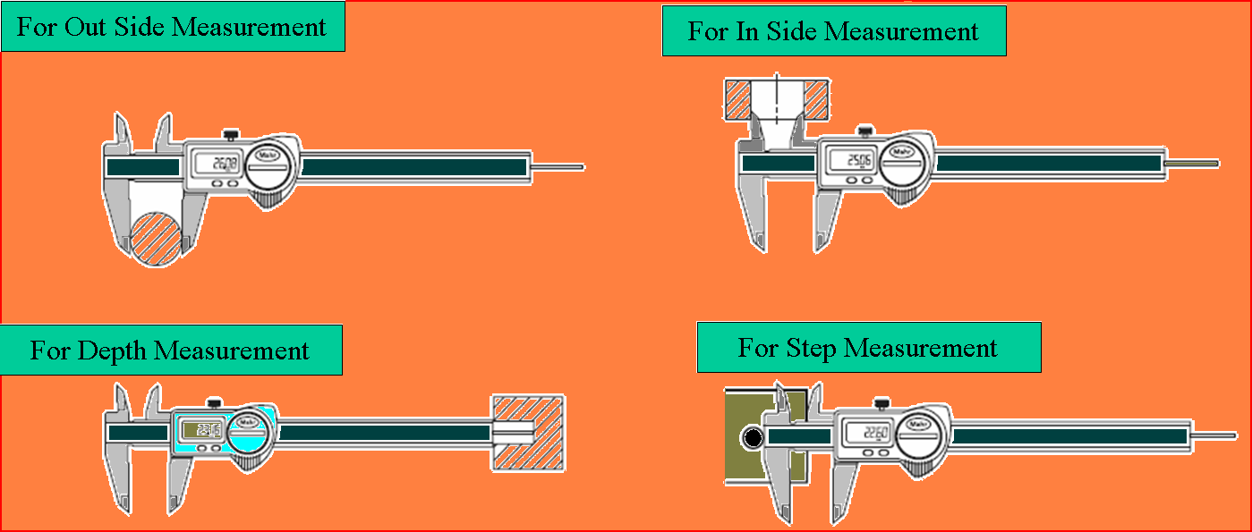
Vernier Calliper: Different uses of Vernier Calliper
.

Slide 30
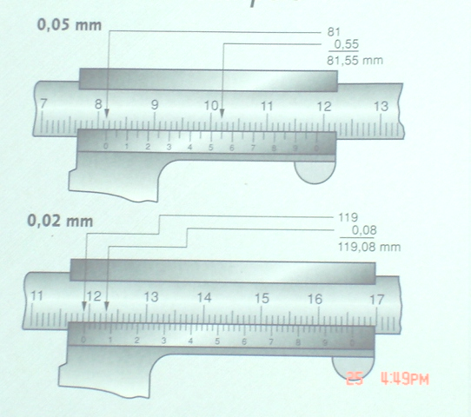
Vernier Calliper: How to Read
.

Slide 31
Geometry

Slide 32
STANDARDISATION

Slide 33
Product Test
Quantity &/or quality
Test object (unit/item) - product/batch or production process
If necessary - inter-laboratory comparison
Types: mechanical, climate, biological, electromagnetic
Objectives: initial research, control, comparative, determinaative
Level: governmental, interagency/inter-institutional/multiagency, internal
According to stage: development, preliminary, comissioning/acceptance
According to type of product:
Plans: NUT & NUN
Notes:
https://kodeksy-kz.com/ka/ob_obespechenii_edinstva_izmerenij.htm

Slide 34
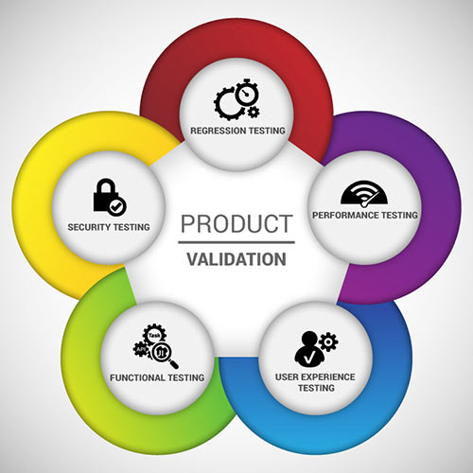
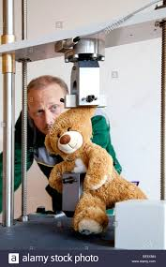
Exercise: product test

Slide 35
Example: biodegradable implants tests
Biodegradability via MW↓↓ / mechanical properties
Biocompatibility
Mechanical properties
Sterility
Documents

Slide 36
Example: biodegradable implants tests
Biodegradability
Biocompatibility
Mechanical properties:
Side bending test (a)
Tensile test (b)
Torsion test (c)
Sterility
Documents

Slide 37
Example: biodegradable implants tests
Biodegradability
Biocompatibility via: ГОСТ ISO 10993-1-2011:
Группа изделий - имплантируемые изделия
Вид контакта - мягкие ткани, кости
Продолжительность контакта - постоянный (более 30 сут)
цитотоксичность;
сенсибилизирующее действие;
раздражение или внутрикожная реакция;
общая токсичность (острая);
подострая и субхроническая токсичность;
генотоксичность;
имплантация.
Mechanical properties
Sterility
Documents

Slide 38
Example: biodegradable implants tests
Biodegradability
Biocompatibility
Mechanical properties
Sterility
Documents:
ASTM F1717 - Standard test methods for static and fatigue for spinal implant constructs in a
corpectomy model
ASTM F2502 - Standard specification and test method for absorbable screws and screws for
internal fixation implants
BS 2782 - Methods of testing plastics - Part 3: Mechanical properties - Method 340B:
Determination of shear strength of sheet material
ISO 13781 - Poly(L-lactide) resins and fabricated forms for surgical implants - In vitro
degradation testing
ISO 15814 - Implants for surgery - Copolymers and blends based on polylactide - In vitro
degradation testing
FDA Guidance - Guidance document for testing biodegradable polymer implant devices

Slide 39
Standardisation
requirements
norms
rules (compulsory/optional)
Object - product, process, service
Functions:
economic
social
communicative
Benefits for:
producer - confirms competitive quality
end user - gets quality
government - guarantees quality

Slide 40
Standardisation: sources
Международной организацией по стандартизации - ISO
Акционерное общество “Национальные информационные технологии” - nitec.kz
Законы РК - online.zakon.kz
Единый государственный фонд нормативных технических документов - egfntd.kz
Казахстанский институт стандартизации и сертификации - kazinst.kz
Проверка стандартов - egov.kz
Комитет технического регулирования и метрологии Министерства по инвестициям и развитию Республики Казахстан → УКАЗАТЕЛЬ нормативных документов по стандартизации Республики Казахстан

Slide 41
Standardisation
В Казахстане существуют различные виды классификаторов, в том числе:
Общий классификатор продукции (ОКП);
Общий классификатор предприятий и организаций (ОКПО)
Общий классификатор видов экономической деятельности, продукции и услуг (ОКДП);
Товарная номенклатура внешнеэкономической деятельности (ТНВЭД);
Общий классификатор стандартов (ОКС).
Стандарт общих технических условий обычно состоит из следующих разделов:
классификация, основные параметры (размеры), общие требования к параметрам качества, упаковке, маркировке, требования безопасности;
требования охраны окружающей среды;
правила приемки продукции;
методы контроля, транспортирования и хранения;
правила эксплуатации, ремонта и утилизации.
Notes:
http://lib.kstu.kz:8300/tb/books/Metrologiya,_standartizatciya_i_sertifikatciya/plain/theory/162.html
https://online.zakon.kz/Document/?doc_id=39053854#pos=1;-58

Slide 42
Standardisation: types
Basic / master / baseline standart (основополагающий стандарт)
Product standard
Process standard
Testing standard
standard for descriptive characteristics
performance standard
safety standard
Reference documents:
guidance manual (методическое положение) → process
descriptive specification (описательное положение) → object

Slide 43
Standardisation: structure
Field of use / designated area (область распространения):
classification
Body / main points (основная часть):
technical
safety
commissioning
testing
labeling, transportation, storage
producer guarantees
Information data (информационные данные):
about standard issuer

Slide 44
Standardisation: example - Термометры
ГОСТ 16920-93
Field of use / designated area (область распространения):
область применения
классификация - Термометры и преобразователи температуры манометрические
Body / main points (основная часть):
основные параметры и размеры
технические требования
требования безопасности
методы испытаний
Information data (информационные данные):
about standard issuer

Slide 45
Standardisation: issuer copyrights
ambiguous: ? owner = order giver
? owner = developer
In practice:
Employer = owner
performer (employee) = author

Slide 46
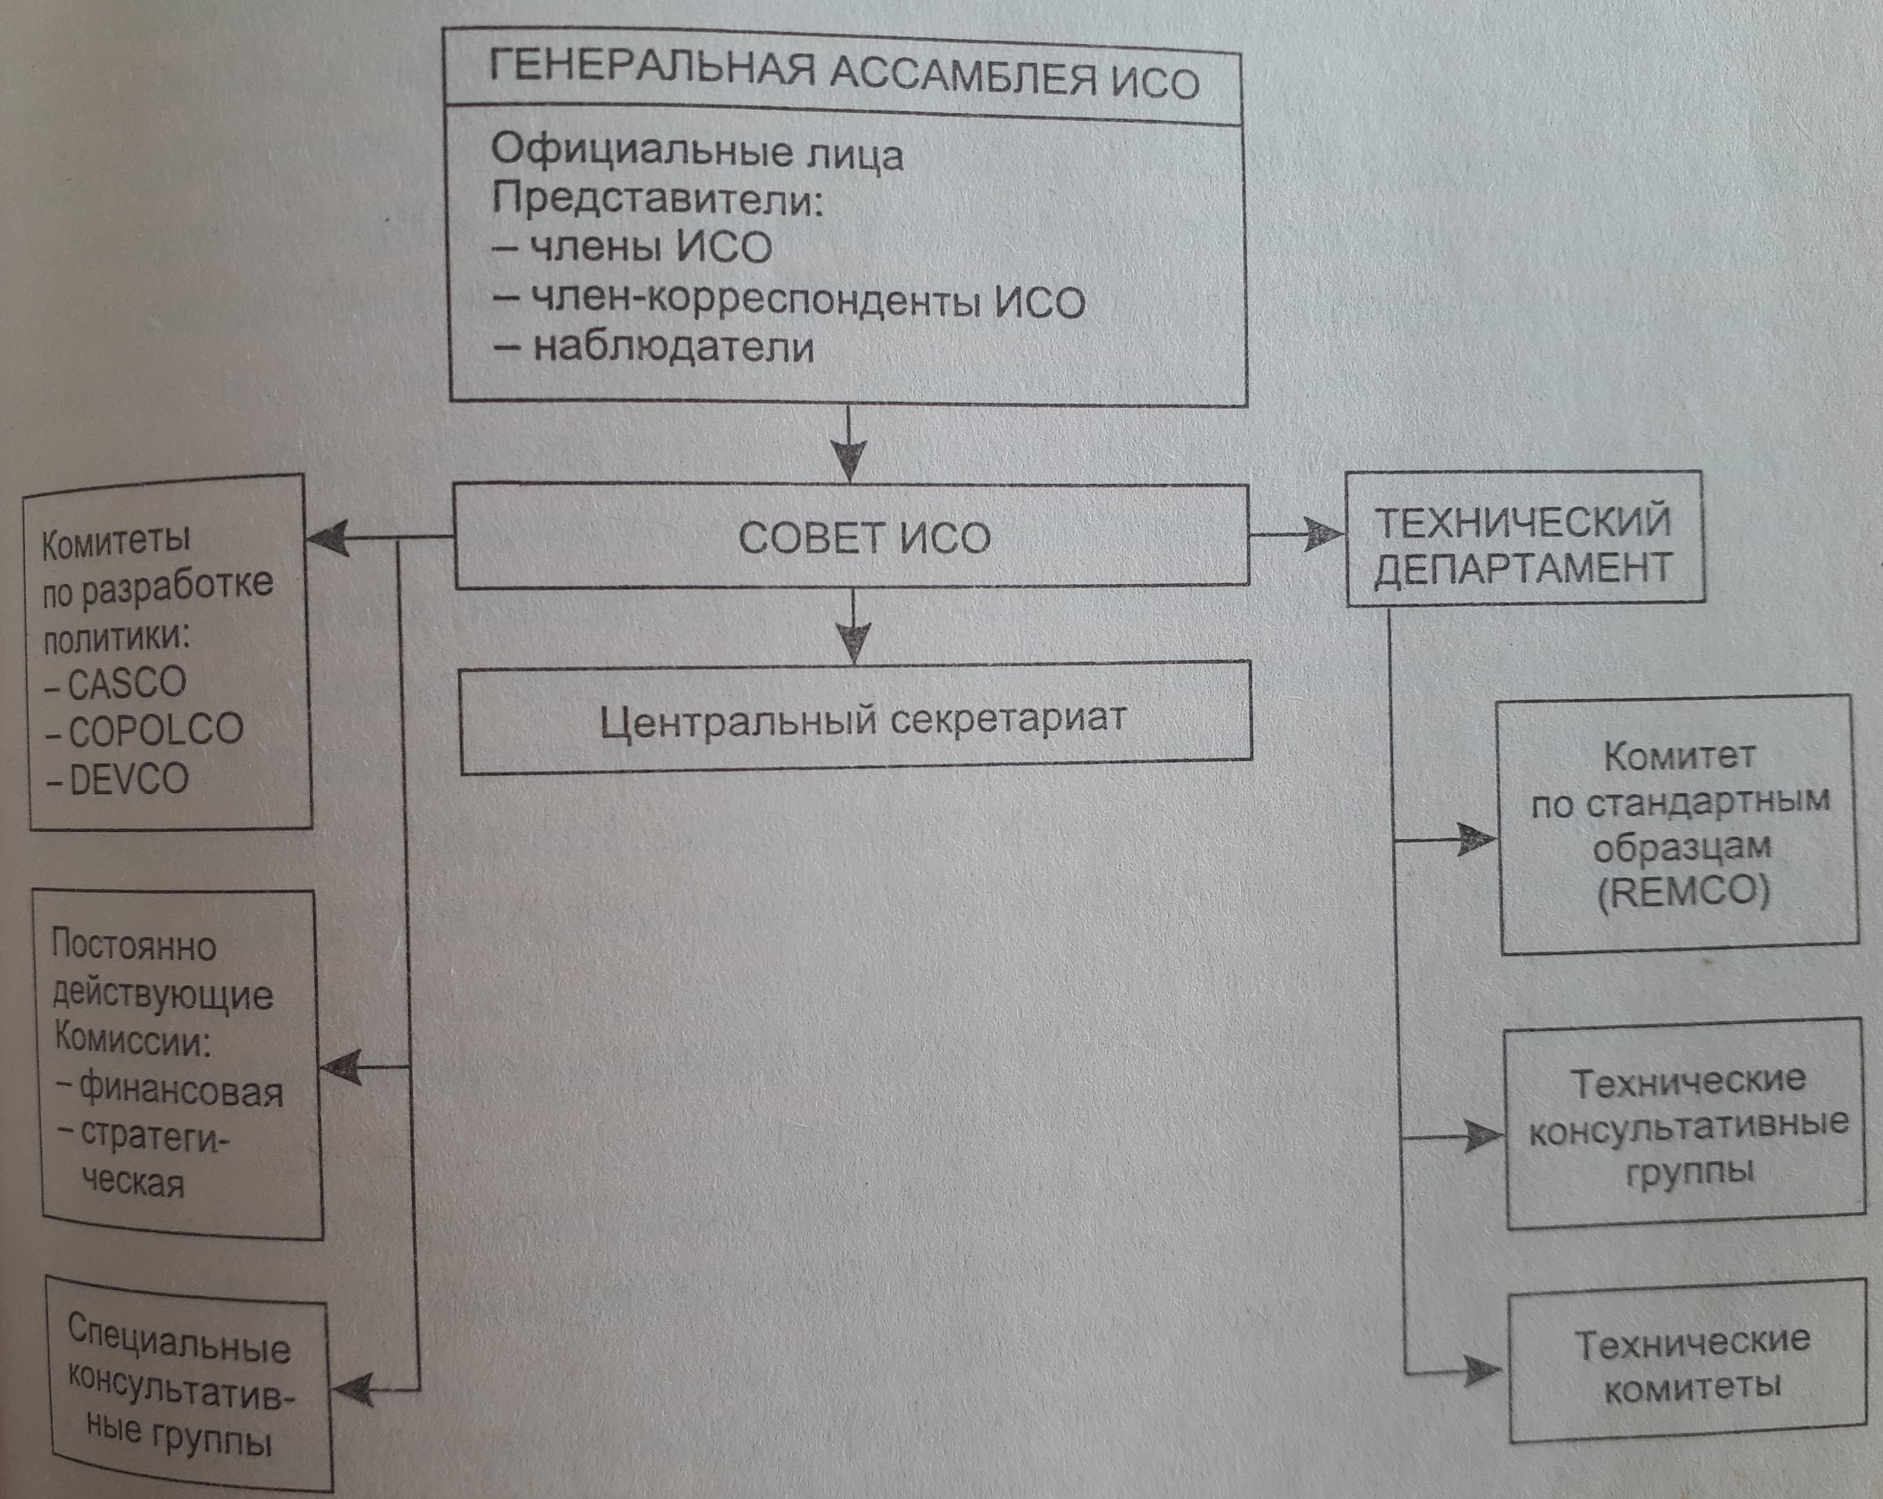
International standardisation organisations
ISO (ИСО):
ПЛАКО
СТАКО
КАСКО
ИНФКО
ДЕВКО
КОПОЛКО
РЕМКО
FAO
WHO
Кодекс Алиментариус
FDA
IEC

Slide 47
Regional and national organisations
CEN - European Committee for Standardization (1961): 17 countries
EN - European standard
HD - Harmonisation Documents
ENV - (Europäischer Normvorschlag) preliminary standard → facilitates implementation of innovations
CENELEC - (Comité Européen de Normalisation Électrotechnique 1971) European Committee for Electrotechnical Standardization: 17 countries
ETSI - European Telecommunications Standards Institute (1988): 24 countries+Australia+Israel (no voting, obeys French law)
INSTA - inter scandinavian standardisation Association (1952): 4 countries+ 10 organisations,
ASEAN - Association of South East Asian Nations (1994): 6 countries
in the CIS - Intergovernmental agreement “О проведении согласованной политики в области стандартизации, метрологии и сертификации” (1992):
МГС - Межгосударственный совет
agreement with MEC and CEN

Slide 48
CERTIFICATION

Slide 49
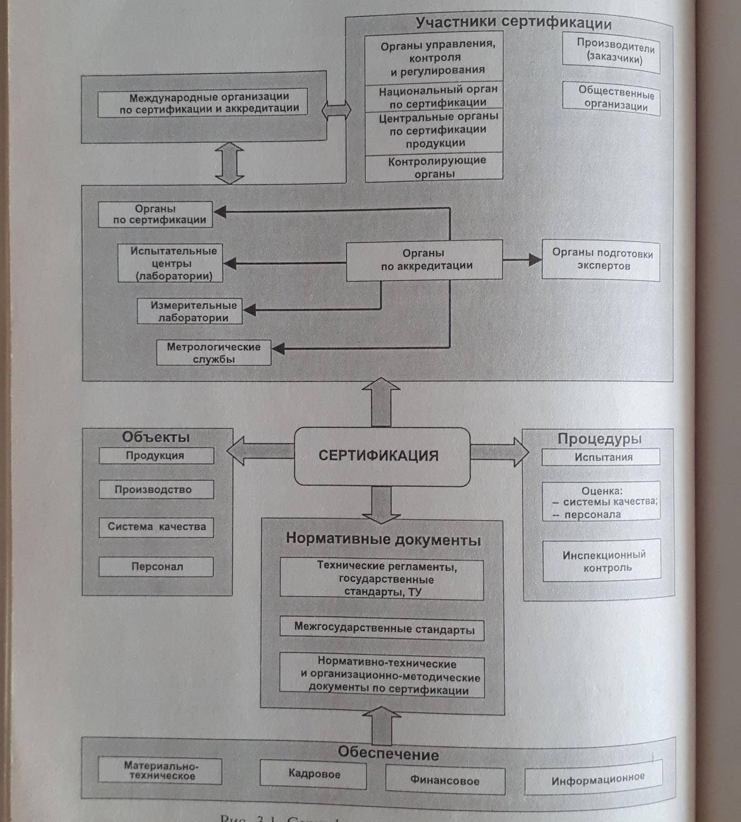
Основные компоненты сертификации

Slide 50
Certification
Whether meets the requirements
Guarantee the quality (customer never has sufficient information/expertise for evaluation)
Gives competitive advantage
Third party (no conflict of interests) - eligible organisation:
government (in case of strategic fields)
accredited organisation

Slide 51
Some conformity marks
French Standardization Association
British Standards Institution (Kitemark)
South Korea

Slide 52
Uniform certification
Appreciate a use of EN 29000 - quality management system and certification on basis of it
EN 45 000
Appreciation creation of centralised accreditation systems
Foundation of certification systems in unregulated areas
Harmonisation of testing and certification systems within EU countries
Legislation with 3rd parties (non-EU countries) of acceptance of testing and certification results

Slide 53
Some international certification organisations
EUROLAB - European testing organisation
EUROCHEM - European analytical chemistry labs cooperation
EQS - European committee for introduction and certification of quality assurance systems
ECITS - European committee for testing and certification in IT
ELSECOM - European committee for testing and certification in electrotechnology
ESCIF - European committee for testing and certification in fire security
EOTC - for certification harmonisation

Slide 54
Some international accreditation organisations
ILAC - International Laboratory Accreditation Cooperation: for experience exchange
IAF - International Accreditation Forum: for unification of system
EA - European Accreditation: organisations cooperation
EXAMPLE-1: HAR - for cables and wires
EXAMPLE-2: EMEDICA for medical electro-equipment

Slide 55
Fields of application and objects of certification.
According to law in Kazakhstan - “Процедуры подтверждения соответствия” Постановление Правительства 4 февраля 2008 года № 90 (далее – Регламент):
Mandatory - in legislatively regulated area (e.g. environment, safety, health)
Optional - in legislatively unregulated area

Slide 56
Structure of certification processes.
подачу и рассмотрение заявки на сертификацию;
принятие решения по заявке, в том числе выбор схемы;
заключение договора на проведение работ по сертификации;
идентификацию, отбор образцов и их испытание;
оценку производства (если это предусмотрено схемой сертификации);
анализ полученных результатов и принятие решения о выдаче (об отказе в выдаче) Сертификата;
регистрацию Сертификата в реестре государственной системы технического регулирования;
выдачу Сертификата;
осуществление инспекционного контроля за сертифицированной продукцией (если это предусмотрено схемой сертификации);
предоставление информации о результатах сертификации.

Slide 57
Декларация о соответствии
оплачивается изготовителем (исполнителем) на договорной основе
вправе принимать физические и юридические лица
в отношении конкретной продукции или группы однородной продукции
не более чем на один год

Slide 58
Декларация о соответствии должна содержать:
1) наименование и местонахождение заявителя;
2) информацию об объекте подтверждения соответствия, позволяющую идентифицировать этот объект;
3) наименование технического регламента, на соответствие требованиям которого подтверждается продукция;
4) заявление заявителя о безопасности продукции при ее использовании в соответствии с целевым назначением и принятии заявителем мер по обеспечению соответствия продукции требованиям, установленным техническими регламентами;
5) сведения о проведенных исследованиях (испытаниях) и измерениях, сертификате системы менеджмента качества, а также документах, послуживших основанием для подтверждения соответствия продукции требованиям, установленным техническими регламентами;
6) срок действия декларации о соответствии;
7) иные сведения, предусмотренные соответствующими техническими регламентами.

